Slide 1

Wireless Classroom Clicker
Portland State University
Team: T08
Notes:
Introduce Team:
Kyle Lu Chris Halseth Michael Schmidt Matt Downey

Slide 2
1
Project Description
2
Motivation
3
Implementation
4
Results
Notes:
Key Idea: What are we going to talk about?

Slide 3
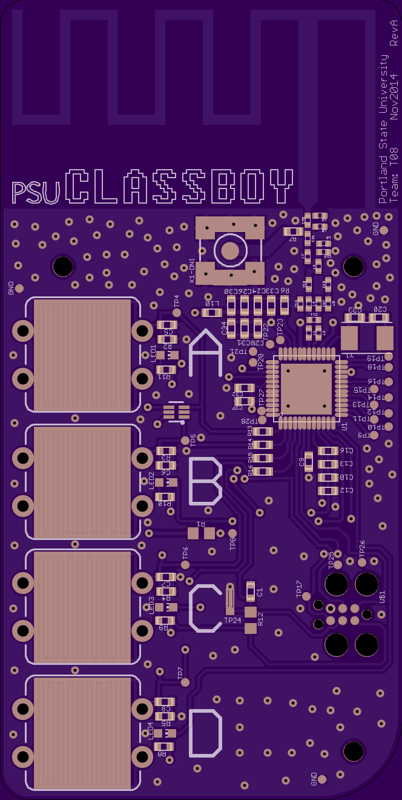
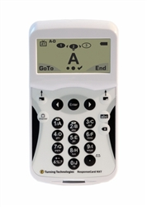
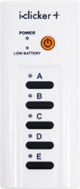
Project Description
Classroom Clicker System
ResponseCard NXT
iclicker +
$9.40
$59.50
$45
Notes:
Key Idea: What is a classroom clicker?
Facilitate real-time feedback system for data polling

Slide 4

Motivation
Notes:
Key Idea: Andrew solicited the class to build a system with his specifications
1st week of class

Slide 5
Requirements
Primary
Cost Sensitive <$15
Minimum 100 Simultaneous Devices
Reliable: <0.1% Loss of Votes
Range: Lecture Hall
Notes:
Key Idea: Primary Design Requirements

Slide 6
Implementation
Satellite
Base Station
Python GUI
PC Platform
Notes:
Key Idea: Modules that were developed for this system
Long Operational Lifetime
2-Way Radio
ISM Band 915 MHz

Slide 7
Implementation
Satellite
Base Station
Python GUI
PC-Platform
Notes:
Key Idea: Modules that were developed for this system

Slide 8
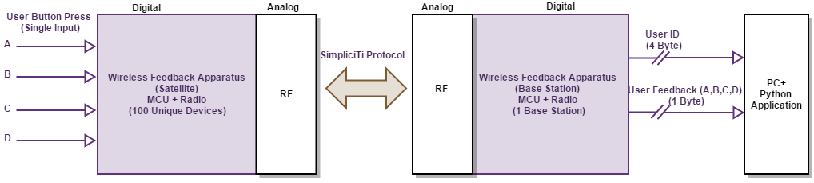
Implementation
Notes:
Key Idea: Functionality
What are the inputs/outputs
How are we transmitting data

Slide 9
Satellite Flow Chart
Connected
Get ACK
n
Sleep Till Button Press
Flash All LED
n
Flash 4x LED
Attempt Reconnect
n
y
y
Tried 5 Times
Send Packet
n
y
n
CNT Base
y
Sleep Till Button Press
Form Packet
Send Packet
Get ACK
Init System
Connected
y
Button LED 2x
Notes:
Key Idea: Modules that were developed for this system

Slide 10
Python GUI Flow Chart
INIT Serial Port
Open Excel Workbook
Init GUI
CNT Base
Update Polling Duration
GUI Main Loop
Reset Bar Graph
Open Polling Loop & Init Count
Close Polling Loop
Close GUI, Serial Port, & Workbook
Display Results
Write Totals to Workbook
Count Answers

Slide 11
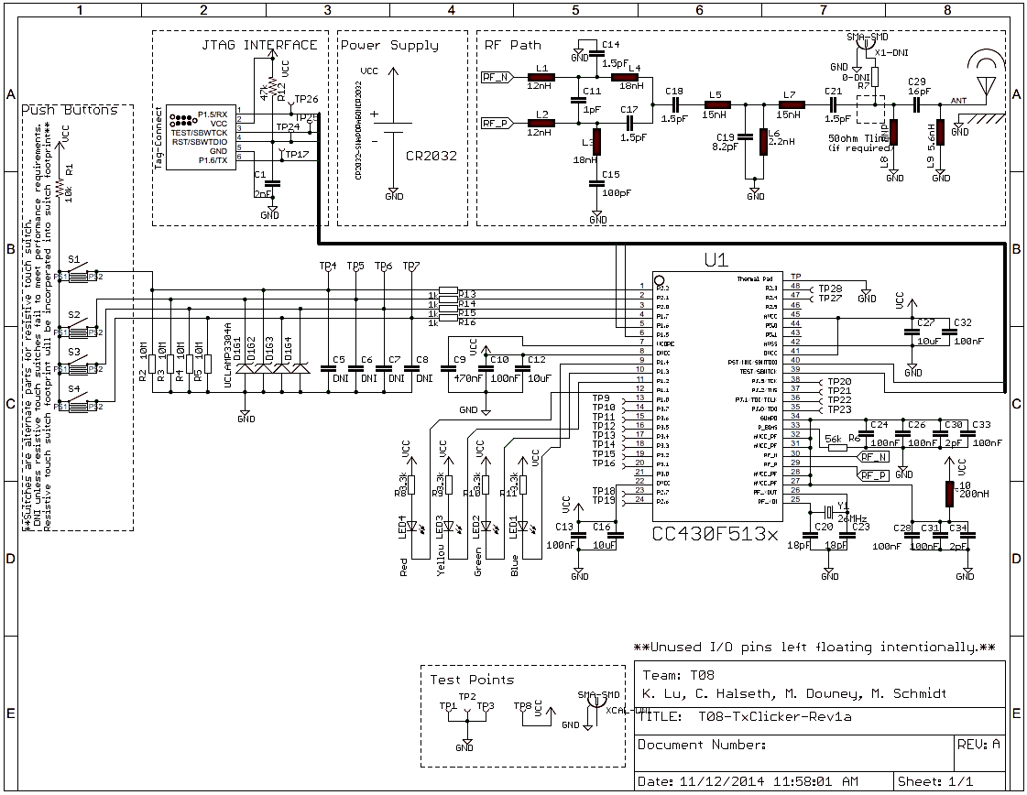
Schematic

Slide 12
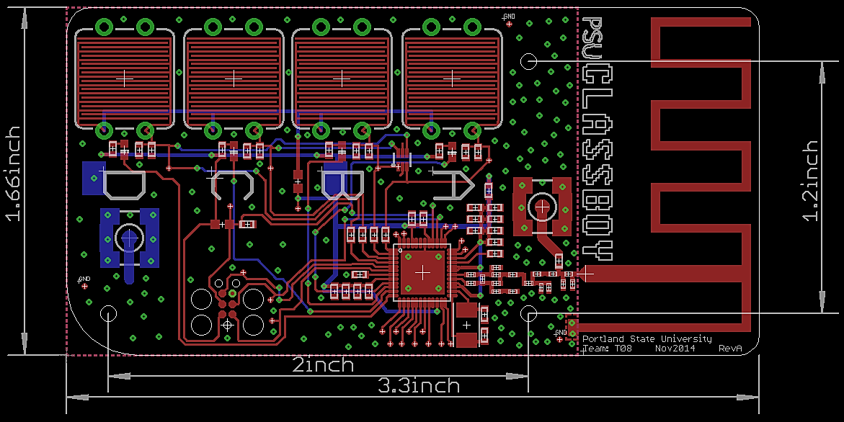
Board Layout

Slide 13
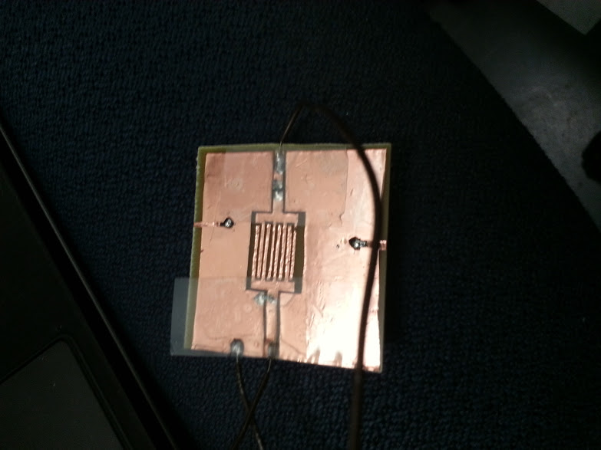
Board Layout

Slide 14
Testing Strategy
Level 1: Unit Testing
Level 2: Integrated Testing
Level 3: System Testing

Slide 15
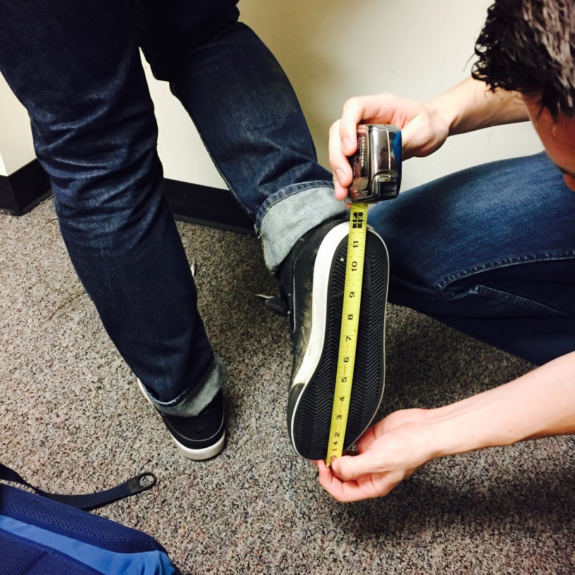
Testing Strategy
Notes:
0.96ft /Michaelfoot ~150

Slide 16
IP and Prior Work
Python Modules
PySerial, Time, CSV, TkInter
MSPExp430F6137Rx User Experience
MSPExp430F5137Rx User Experience
Texas Instruments SimpliciTI Protocol

Slide 17
Contributions
K. Lu System Level Design Schematic/PCB Layout Construct 4x Boards Bill of Materials Documentation Review | C. Halseth RF Antenna Design Resistive Button Design Base Station Program Satellite Program ~1000 Lines of Code PCB Layout
M. Schmidt Python GUI Development ~380 Lines of Code Developed Export Data Algorithm System Test & Verification | M. Downey System Test & Verification System Documentation Code Review

Slide 18
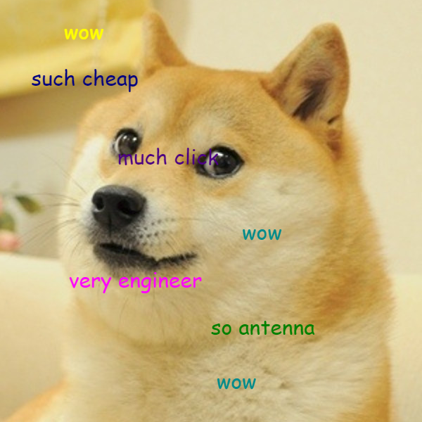
Demonstration
Q1: “wow, such cheap, much click, very engineer, so antenna, wow!”
Press: A, B, C, or D

